Slide 1
Coupling of Design Patterns: Common Practices and Their Benefits
- What is a design pattern?
A software design pattern is a general, reusable solution to a commonly occurring problem within a given context in software design. It is not a finished design that can be transformed directly into source code.
In a single file we need to decide relation of functions. (functional programming). When we start programming with multiple classes that each have their own data and methods we need to decide relations of classes aswell.
Design patterns may be viewed as a structured approach to computer programming intermediate between the levels of a programming paradigm and a concrete algorithm.
Effective software design requires considering issues that may not become visible until later in the implementation. Again, on a smaller scale, if you were to start programming before deciding on how to solve the problem, you would most likely get stuck and start again.

Slide 2
- Abstract
Object-oriented (OO) design patterns define collections of interconnected classes that serve a particular purpose.
When designers treat patterns as structural units, they become concerned with issues such as coupling and cohesion at a new level of abstraction. When we used statements as building blocks, we created rules such as structured programming. Now we start programming with multiple classes so we deal with issues of having them as building blocks(which are higher level, a new level of abstraction).

Slide 3
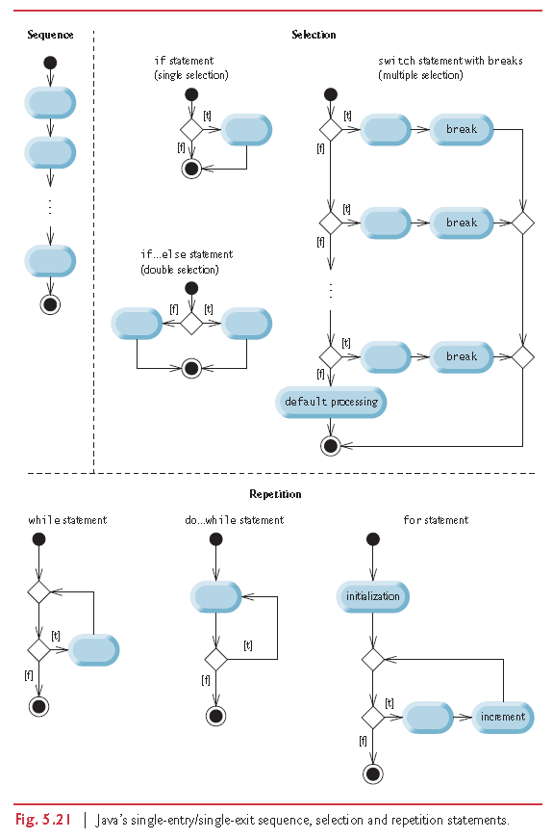

Slide 4
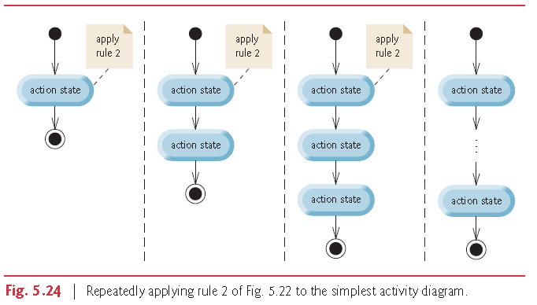

Slide 5
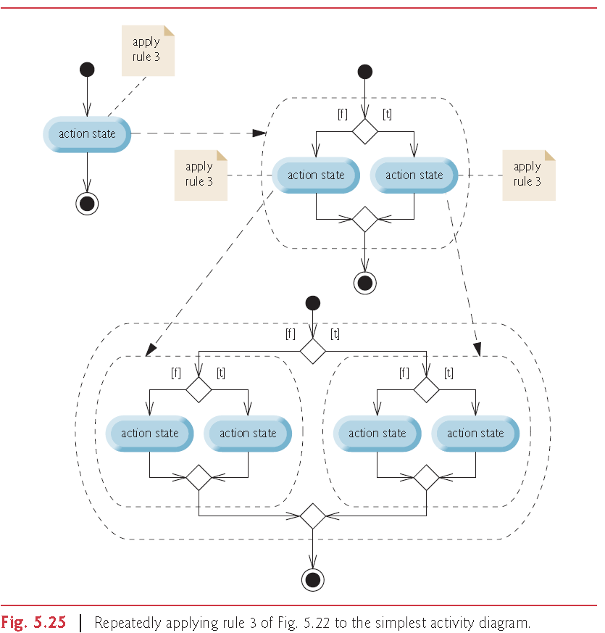

Slide 6
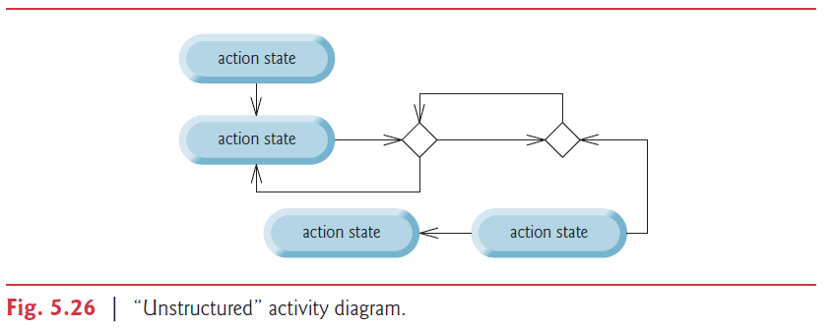

Slide 7
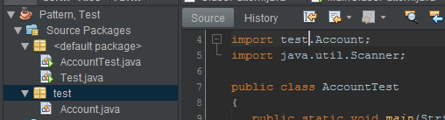

- Cohesive
Account class is in src\test folder while AccountTest class is in src folder. So we import Account class using import test.Account. Normally cohesive classes like these would be together in the same package.

Slide 8
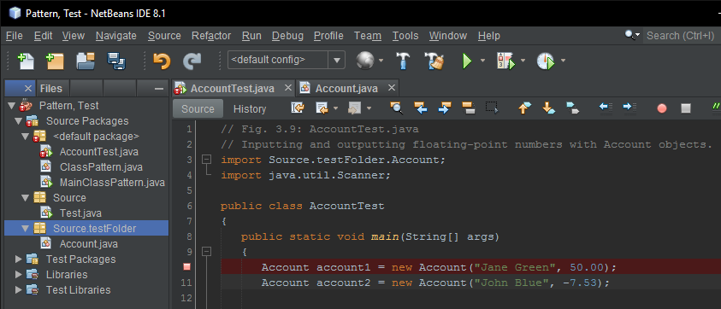
Account class is in src\Source.testFolder and AccountTest class is in src folder. So we import Account class using import Source.testFolder.Account (just like java.util.Scanner). Important note: you dont import a class in default package(src root folder) so dont use it.

Slide 9
- Coupling
The degree of interdependence between software modules.
It is a good programming practice to create your software out of independent modules as much as possible.
That way your program can look like a building made out of blocks instead of a bowl of spaghetti.

Slide 10
- Abstract
We examine the notion of pattern coupling to classify how designs may include coupled patterns.
We find many examples of coupled patterns; this coupling may be “tight” or “loose”, and provides both benefits and costs.
We qualitatively assess the goodness of pattern coupling in terms of effects on maintainability, factorability, and reusability when patterns are coupled in various ways.

Slide 11
1. Introduction
Design patterns are architectural units, just as classes are implementation units. We can view a system as a collection of interacting patterns and independent classes.
Pattern coupling results from connections between patterns. Common classes can connect two patterns. They play
roles in more than one pattern by referencing common objects, and by using methods in another pattern.

Slide 12
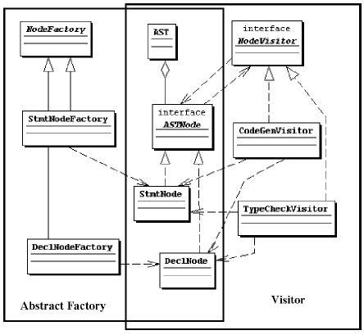

1. Introduction
In this example, an instance of an Abstract Factory pattern is coupled with an instance of a Visitor pattern through shared classes. Interface ASTNode, classes AST, StmtNode, and DeclNode play roles in both patterns. A change in parts of one pattern can affect the behavior of the other pattern.

Slide 13

1. Introduction
Although we have not found the notion of pattern coupling discussed in the literature, we found numerous examples
of coupled patterns. In this paper, we study the 23 patterns described in Gamma et al.

Slide 14
2. Approach
We examined the available literature describing specific design pattern applications to find examples of pattern coupling
using the following process:
1. Survey recent literature concerning design pattern applications
for examples of interconnected patterns.
2. Compile a list of all example instances of Gamma et al
design patterns found in the literature.
3. Create a sub-list of all groups of patterns used as pairs
or multiple sets of interacting Gamma et al patterns.
4. Group the list into categories of coupling types (tightly
versus loosely coupled) and interaction types (intersection,
composition, or embedding) with a rationale for
each grouping.
5. Evaluate the identified instances of coupled patterns in
terms of desirable software qualities (maintainability,
factorability, reusability, and ease of implementation)
with rationale for each grouping.
6. Analyze the data to better understand the pattern coupling
techniques that, in general, tend to contribute to
design “goodness” and which ones should be used only
to satisfy specific application needs.

Slide 15
3. Study Design Patterns
The study pattern set consists of the 23 Gamma et al OO patterns. The patterns are categorized into their three main groups and listed below with descriptions quoted from Gamma et al.
Creational Patterns: In software engineering, creational design patterns are design patterns that deal with object creation mechanisms, trying to create objects in a manner suitable to the situation.
Structural Patterns: Structural design patterns are design patterns that ease the design by identifying a simple way to realize relationships between entities.
Behavioral patterns are concerned with the assignment of responsibilities between objects, or, encapsulating behavior in an object and delegating requests to it.

Slide 16
Creational Patterns.
Factory Method: “Define an interface for creating an object, but let subclasses decide which class to instantiate.”
Abstract Factory: “Provide an interface for creating families of related or dependent objects without specifying their concrete classes.”
Builder: “Separate the construction of a complex object from its representation so that the same construction process can create different representations.”
Prototype: “Specify the kinds of objects to create using a prototypical instance, and create new objects by copying this prototype.”
Singleton: “Ensure a class only has one instance, and provide a global point of access to it.”

Slide 17
Structural Patterns.
Adapter: “Convert the interface of a class into another interface clients expect.”
Bridge: “Decouple an abstraction from its implementation so that the two can vary independently.”
Composite: “Compose objects into tree structures to represent part-whole hierarchies.”
Decorator: “Attach additional responsibilities to an object dynamically.”
Facade: “Provide a unified interface to a set of interfaces in a subsystem.”
Flyweight: “Use sharing to support large numbers of fine-grained objects efficiently.”
Proxy: “Provide a surrogate or placeholder for another object to control access to it.”

Slide 18
Behavioral Patterns.
Chain of Responsibility: “Avoid coupling the sender of a request to its receiver ... Chain the receiving objects and pass the request along the chain until an object handles it.”
Command: “Encapsulate a request as an object, thereby letting you parameterize clients with different requests...”
Interpreter: Given a language, define a representation for its grammar along with an interpreter.”
Iterator: Provide a way to access the elements of an aggregate object sequentially without exposing its underlying representation.”
Mediator: “Define an object that encapsulates how a set of objects interact.”
Memento: “Capture and externalize an object’s internal state so that the object can be restored to this
state later.”
Observer: “Define a one-to-many dependency between objects so that when one object changes state, all its dependents are notified and updated.”
State: Allow an object to alter its behavior when its internal state changes.”
Strategy: “Define a family of algorithms, encapsulate each one, and make them interchangeable.”
Template: “Define the skeleton of an algorithm in an operation, deferring some steps to subclasses.”
Visitor: “Represent an operation to be performed on the elements of an object structure.”

Slide 19
4. Papers Included in the Study
Several criteria were applied to the set of papers to support consistent analyses of pattern examples:
1. Each paper must have contained at least 1 pattern from Gamma et al [8] to be included in the study.
2. Papers were not excluded from the study if they did not contain coupled pattern combinations to add to the total
data set. This allowed a realistic depiction of the actual prevalence of coupling in practice.
3. Individual pattern recognition was based on the actual documentation using the name of the pattern.
4. We identify pattern combinations either fromactual direct references in the research papers or from their indirect
recognition after a review of the pattern structures presented in the papers.
5. The classification of the patterns into groups according to coupling type (loose vs tight) and interaction type (embedded, interactive, and composite) was accomplished via paper inspection by a single reviewer without subsequent independent validation.

Slide 20
Approximately one third of the papers that we found describing pattern use was rejected due to failure to find even one instance of a documented design pattern from Gamma et al
The final selected set of 16 papers used in this study consisted of a fair distribution of papers from industrial applications and
analytical studies. We classified the papers into the following four categories based on the nature of the study and the source of data:
Pure Analytical Study. Four studies consist of abstract analytical application of ideas that are not applied to real world problems [3, 4, 6, 11].
Analytical study with synthetic examples. Three studies include synthetic examples which are abstractions of realistic problems that can occur in commercial software development [10, 13, 15].
Industry case studies of existing code. Five studies locate existing pattern architectures, or update existing designs to make use of patterns [1, 2, 7, 9, 18].
Industry Case Studies of new designs. Four studies examine new or recent development projects which deliberately makes use of patterns during the design phase [5, 14, 16, 17].

Slide 21
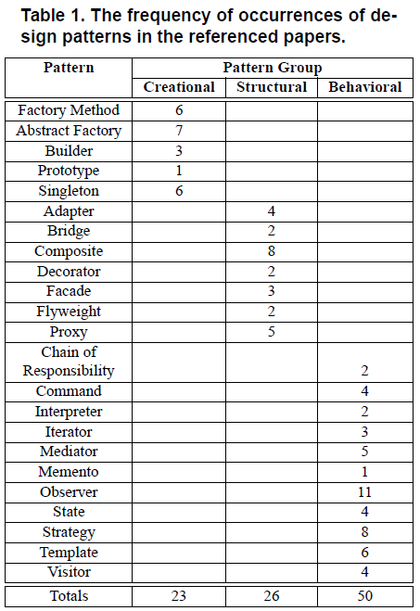
5. Pattern Occurrences
The occurrence of patterns in the selected papers was also quite evenly distributed among the Gamma et al patterns.
Certain patterns appear to be more desirable based on their frequent usage.
Most of the more popular patterns support interface abstraction and reusability.

Slide 22
6. Pattern Coupling
We identified all coupled patterns. Such coupled patterns consist of all pattern pairs or multiples that are connected.
We classified the sets of connected patterns in terms of loose vs. tight coupling, and pattern interaction types:
Coupling types.
Loosely Coupled: Patterns are loosely tied together with few connections, making it easier to separate the patterns. They should promote quicker, simpler future design changes.
Tightly Coupled: Patterns are tightly tied together with many links and dependencies. Minor changes to one of the patterns will be difficult without affecting the other(s).

Slide 23
Pattern Interaction Types.
Intersection: Intersecting patterns exhibit a “talks to” or “uses a” communication and interaction scheme. We classified a pattern as an intersection type when there was no evidence that it was either a Composite, or an Embedded type.
Composite: Composite patterns have pattern elements as components. These components are wholly contained in the composite pattern. Composite patterns are recognizable as a “together make up a” relationship — the composite has emergent properties not found in the parts. The composites that we found are not listed as patterns
in Gamma et al [8].
Embedded: Embedded patterns represents the interaction best described as a “has a” relationship. The parent pattern includes an instance of the embedded pattern in it. It differs from the composite in that the parent pattern is not a composite of multiple patterns, but has independent content in addition to the embedded pattern. It differs from the intersection “uses a” scheme; the used pattern is entirely within the using pattern’s structure.

Slide 24
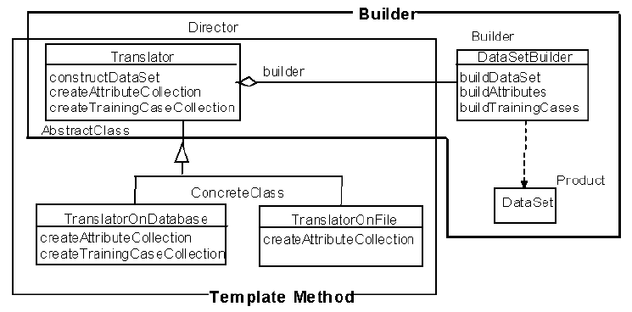

We found 17 coupled pattern multiples. The identification of coupled patterns was easy in some cases using the descriptions in the examples. In other cases, the reviewer recognized patterns by examining the class structure.
Figure 2 shows an example of one of the coupled patterns found in Masuda et al [10]. In this example, an instance of a Template Method pattern is coupled with an instance of a Builder pattern through a shared class. Class Translator plays a role in both patterns. The interaction is of the type “talks with a” which places the patterns into the “Intersection” grouping.
Most of the sets of coupled patterns are intersections.

Slide 25
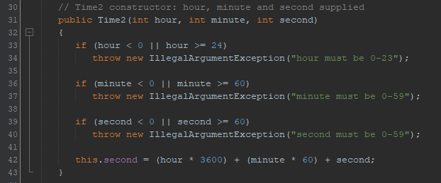
7. Pattern Coupling and Design Quality
Ultimately, we are concerned with the relationship between pattern use and external quality factors such as maintainability,
reusability, and factorability— the ability to restructure a system design.
Embedded patterns are not easily modifiedwithout affecting the parent pattern, and modifications of composite patterns
affect their “composite parent”. The use of an embedded or composite pattern set is best delegated to those application
specific needswhere there is not likely to be a need for future modification of the component patterns in lieu of modifying
the overall parent.
We expect the use of pattern Intersections to continue to predominate in pattern coupling instances, since the need to connect patternswith each other to promote modularity and factorability will remain and that is what Intersection type couplings can support.
We can think of some Java programs to better understand intersection. Set and get methods allow us to safely do our business without caring about implementation. For example you don’t care whether the server is keeping time as

Slide 26
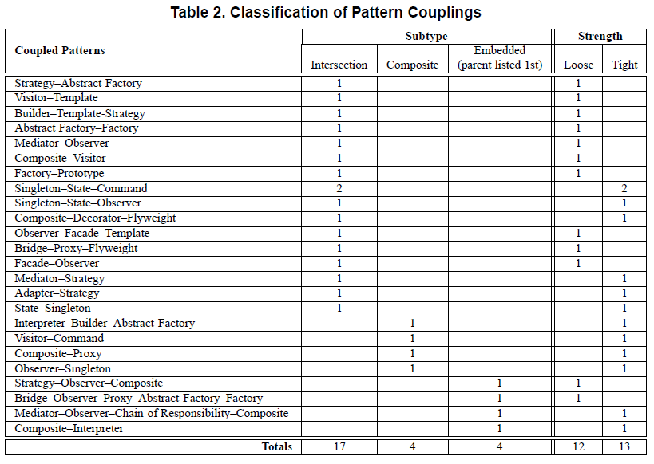

Slide 27
Unfortunately, the use of Intersection type pattern couplings does not guarantee good software designs. Intersections can create both loosely and tightly coupled patterns.
As expected, all of the embedded couplings are tightly coupled.
The composite couplings are evenly divided between loosely and tightly coupled pattern sets, in part, because, if there were tight couplings between any of the patterns (i.e. one embedded pattern), then we classified the entire pattern set was as tightly coupled.
We expected a high preponderance of loosely coupled pattern sets among those classified as Intersection couplings. However, we see far more tightly coupled Intersections that we expected.
One explanation is that the Singleton pattern is a popular embedded type and its use resulted in a classification of tightly coupled wherever it is applied. Couplings involving the Singleton pattern are notable exceptions to the rule that patterns should
be loosely coupled. It is typically used in an application specific context that developers do not expect to be modified after the first use in a design.
The results of the study tend to bear out the traditional views on designing for software quality. Maintainability, factorability, and reusability are all supported by modular software with loosely coupled interfaces and abstraction of details to prevent modification of one component from impacting others.
Both industry and academic software development papers were in agreement on the value of modular software. The use of patterns not conducive to loose coupling is not eliminated, but rather delegated to specific applications where the impact on modularity is minimized.

Slide 28
8. Limitations
The greatest threat to the validity of our results is a limited data set.
First, the composite pattern sets are all from the same data source
Second, we classified coupled pattern sets into the default “Intersection” category if it did not meet the criteria of another category.
Finally, we depended on a manual process for classification using one evaluator, the first author.
Future research should use an expanded data set, more refined classification criteria, and either an automated classification mechanism or independent expert assessments.

Slide 29
9. Conclusions
-We find examples of coupled OO design patterns in theoretical and applied research as well as in industry case studies.
The examples are split nearly evenly between sets of tightly coupled patterns and sets of loosely coupled patterns.
Sets of coupled patterns classified as exhibiting Composite Coupling and those containing an instance of the Singleton
pattern tend to be tightly coupled. However, expanded data is needed to generalize the results to the set of all OO software
designs.
-Further studies should lead to an understanding of which pattern constructs are effective and lead to more adaptable systems for particular applications.
Eventually this work may lead to mechanisms to evaluate macro pattern couplings for new Composite patterns or pattern languages.
-Patterns are clearly becoming a popular design mechanism, and as their use increases, there will be a growing need for good pattern coupling methods—if we design a system as a set of patterns, these patterns must communicate.
By examining how patterns have been coupled in published examples, we can better understand the benefits and costs of design options involving connected patterns.

